Slide 1
DRILLVCS
VERSION CONTROL SYSTEM FOR ANYONE
--Satyendra chandan

Slide 2
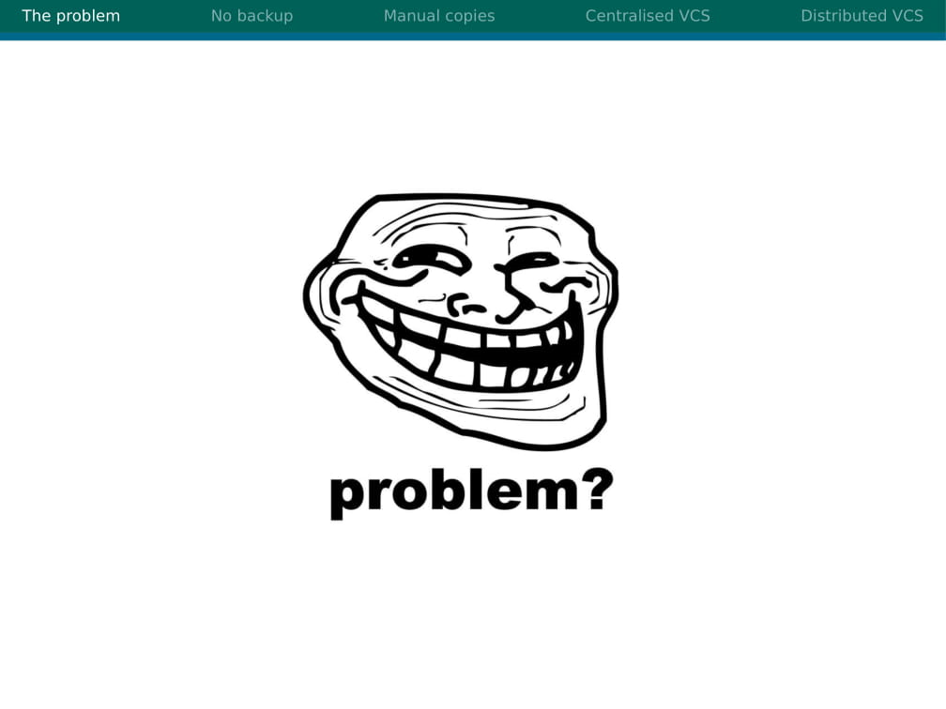

Slide 3
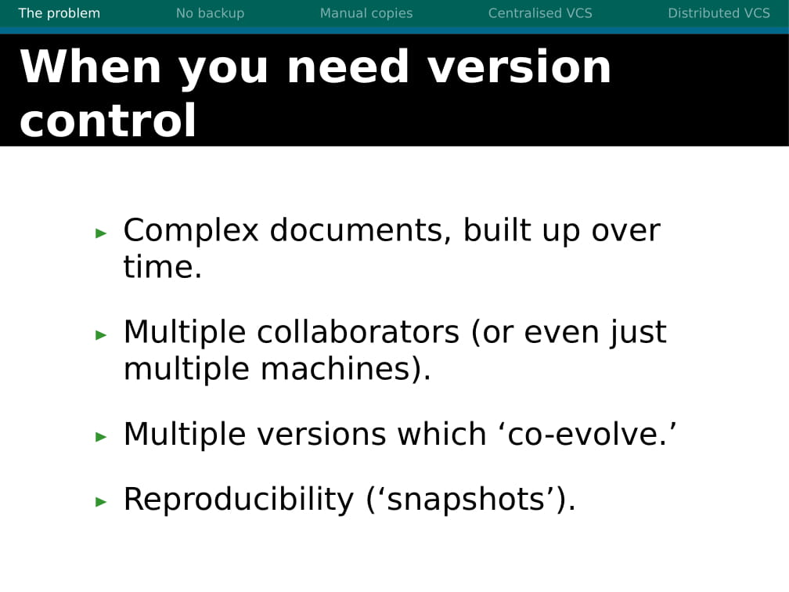

Slide 4
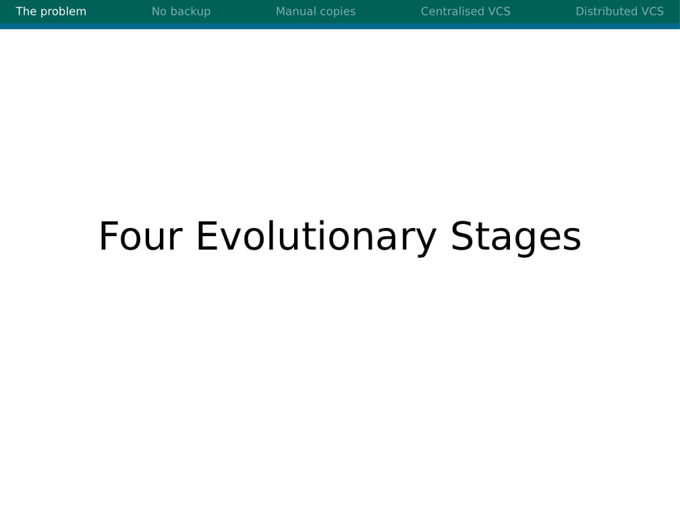

Slide 5
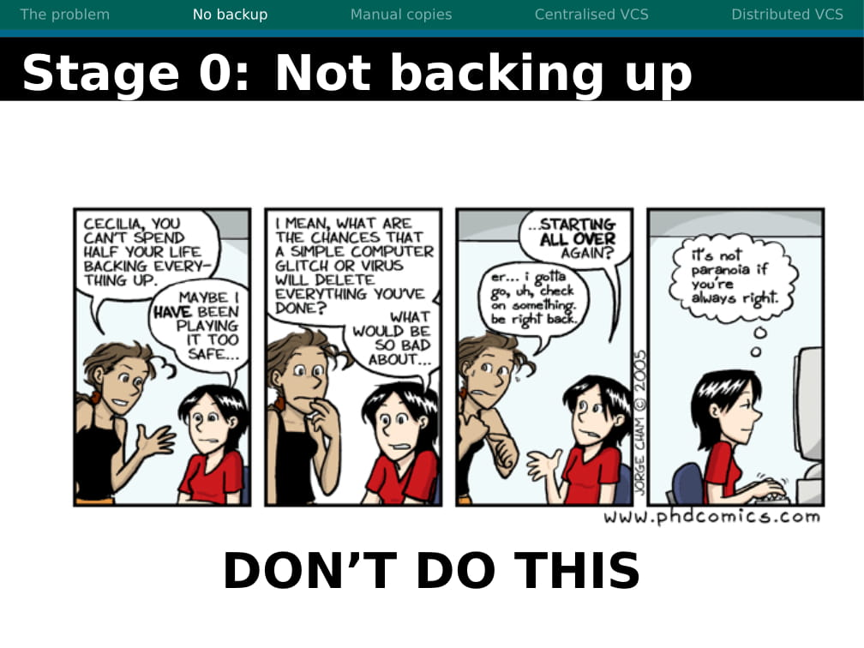

Slide 6
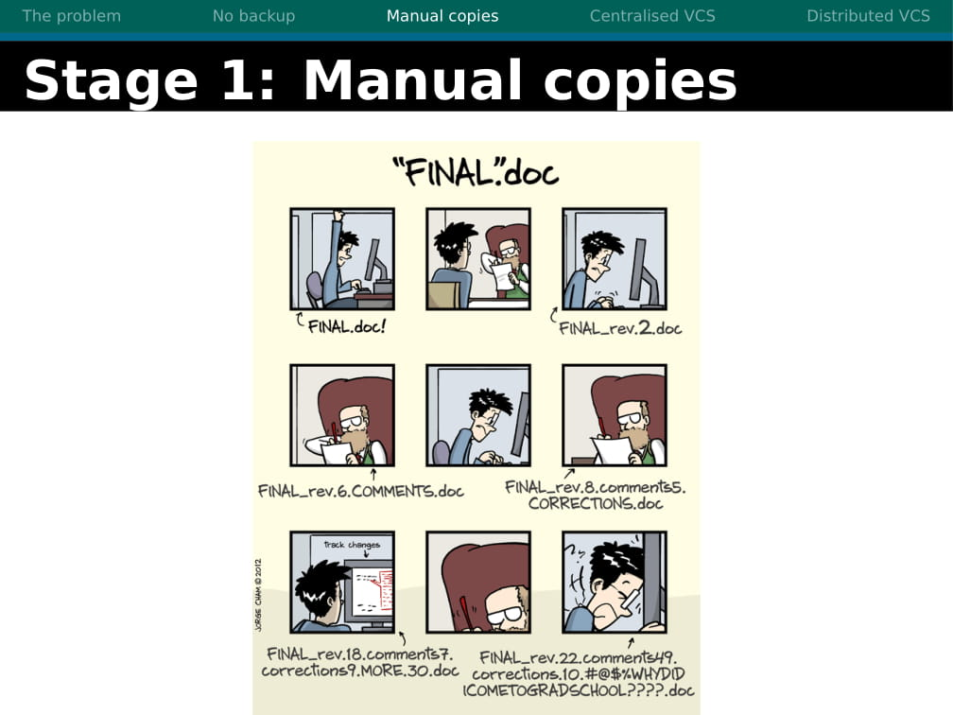

Slide 7
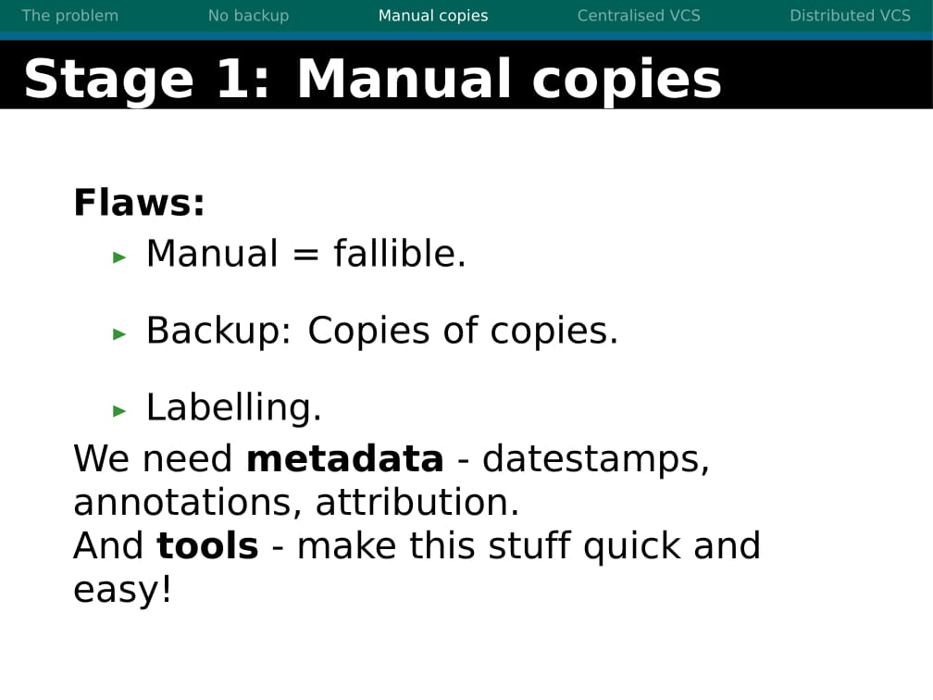

Slide 8
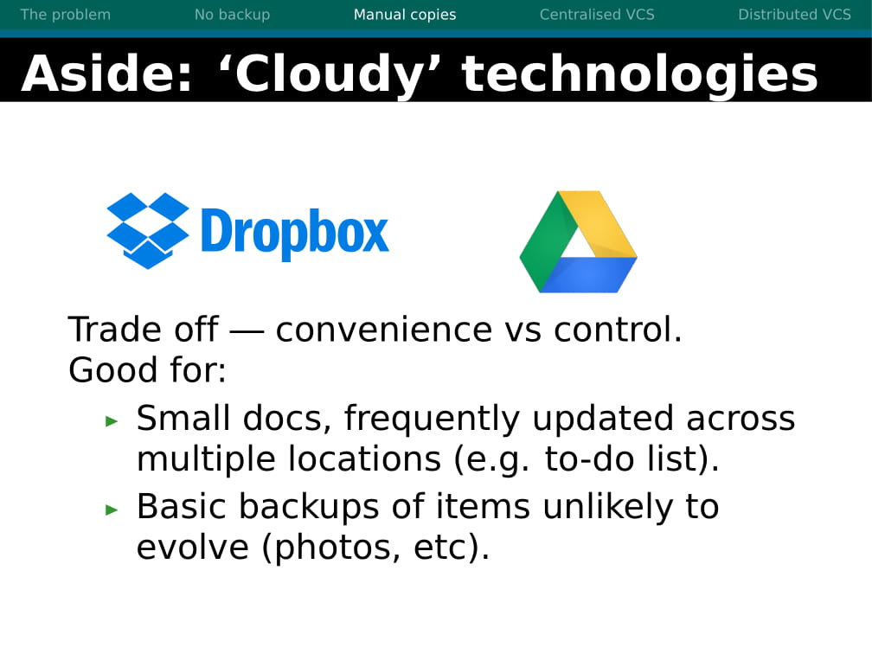

Slide 9
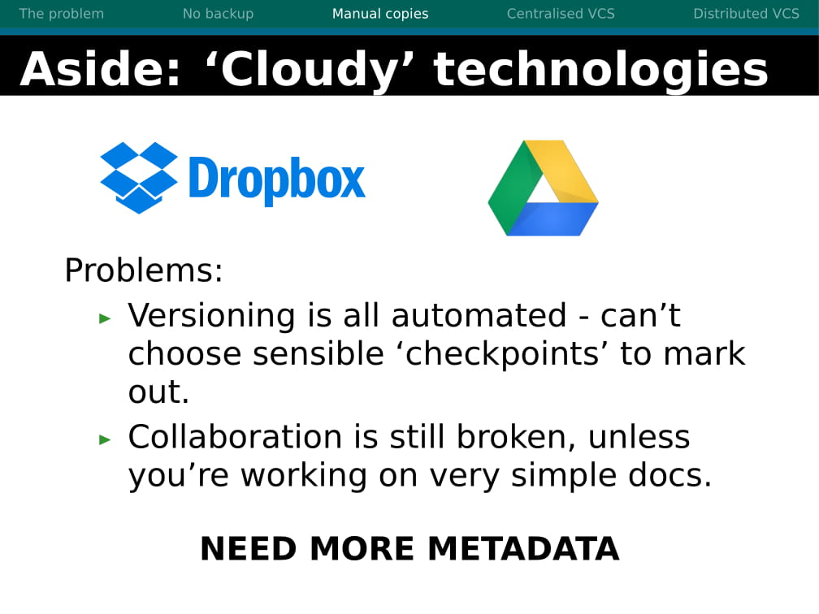

Slide 10
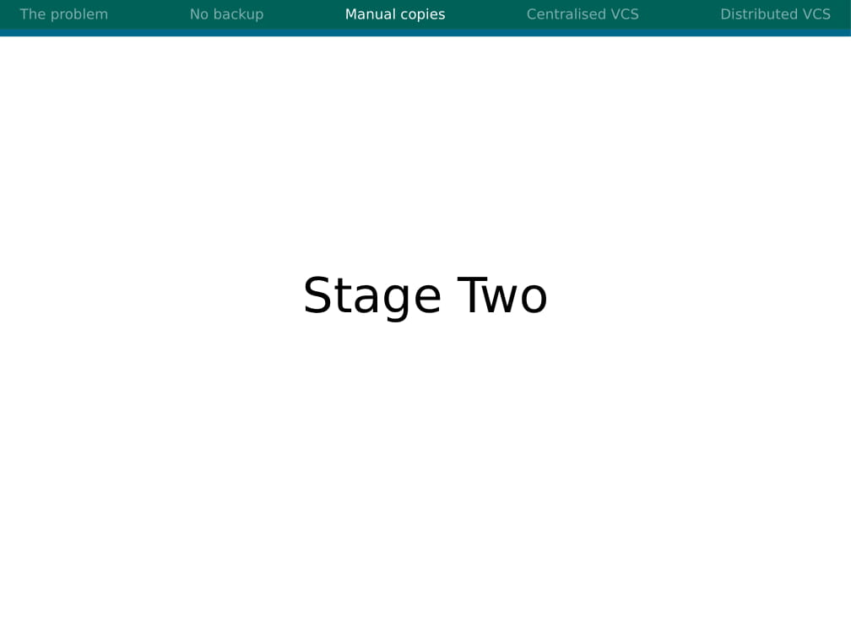

Slide 11
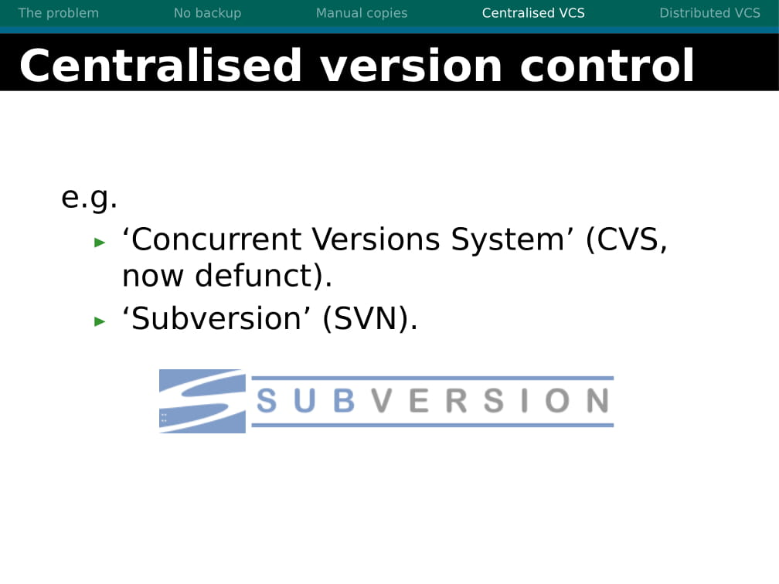
DrillVCS
Version Control system for anyone

Slide 12
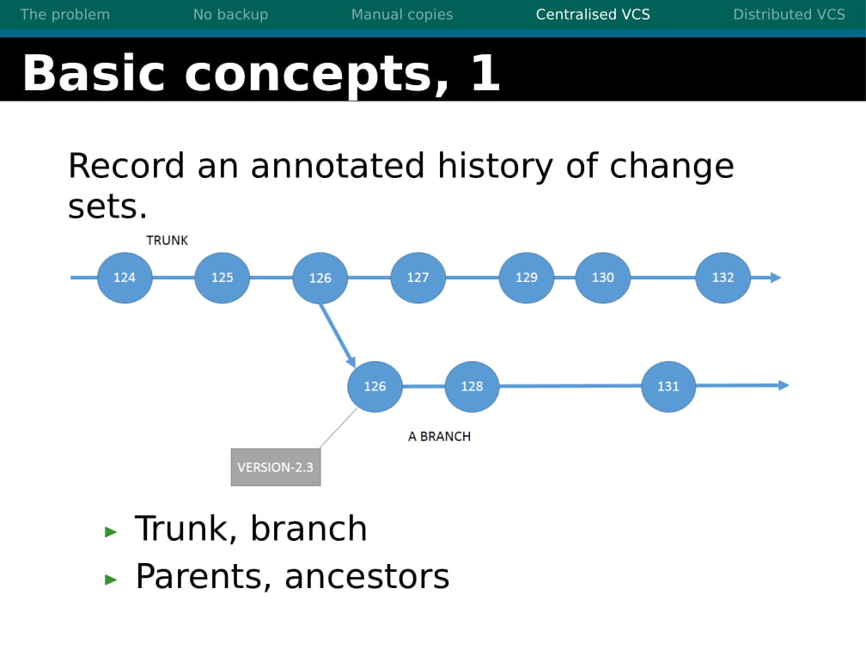

Slide 13
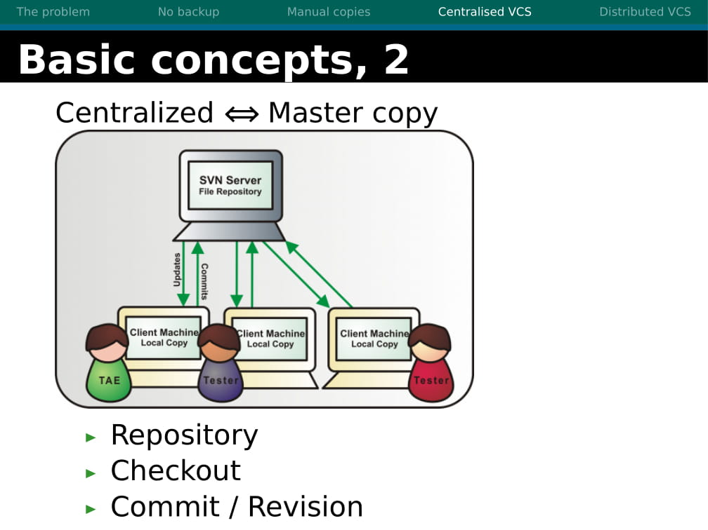

Slide 14
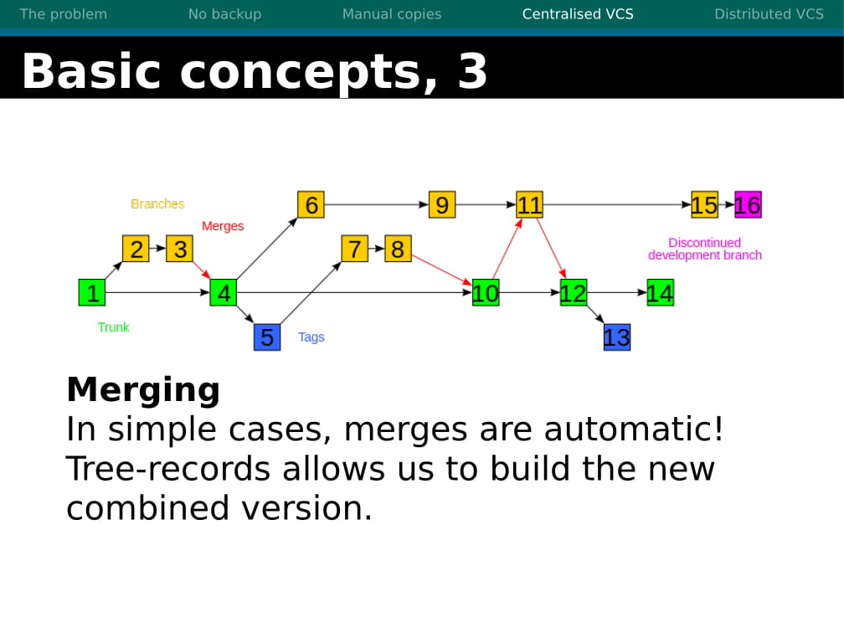

Slide 15
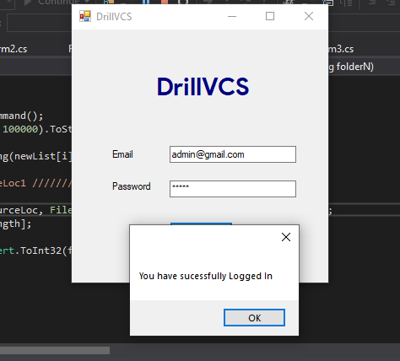
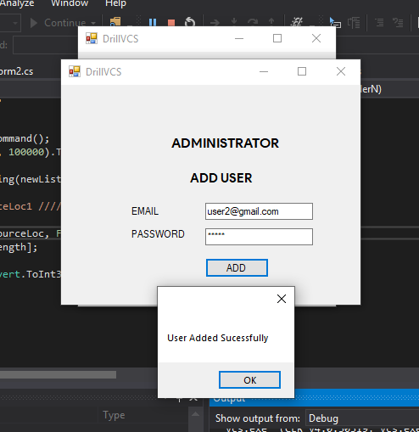
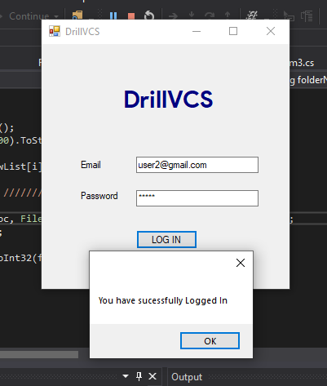
Administrator Login
Administrator can add user
Client Login

Slide 16
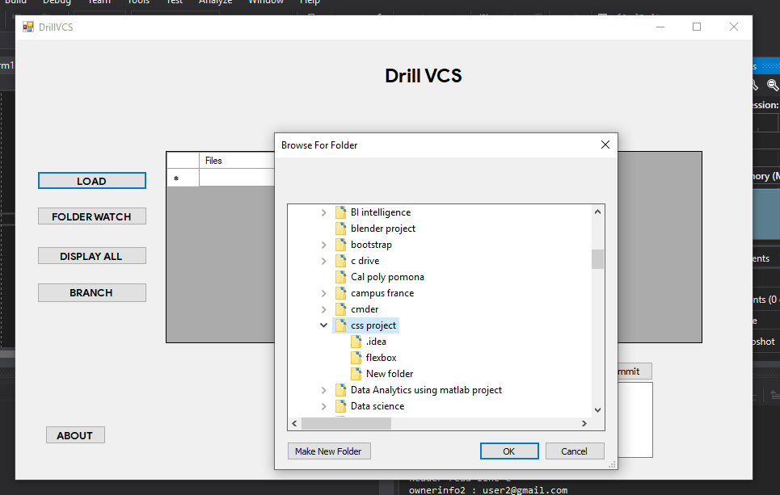
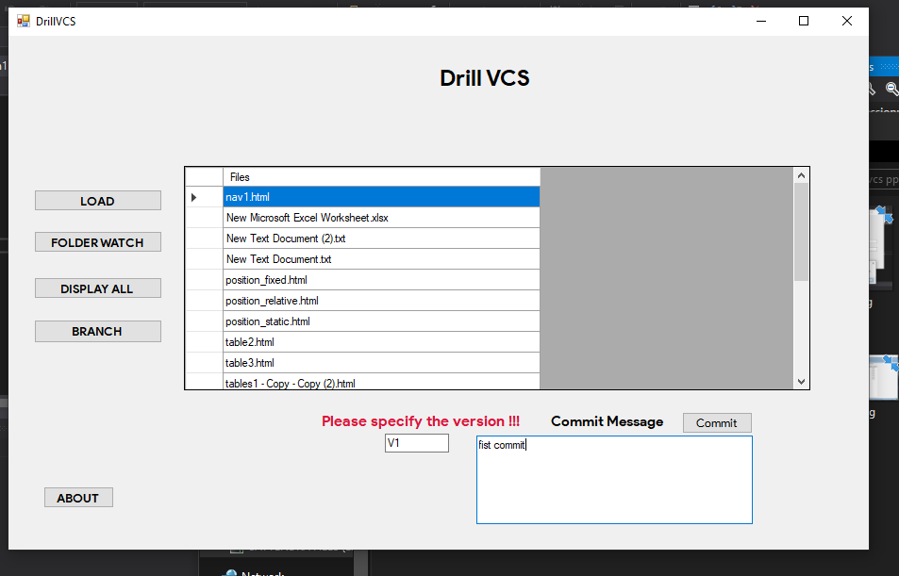
DrillVCS
Load the project
List the files in the project
Technology used:
C# .Net
Oracle Database

Slide 17
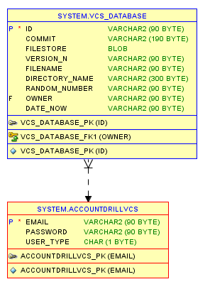
DATABASE SCHEMA

Slide 18
Specify the version number and commit message and press commit
Files are added to the database

Slide 19
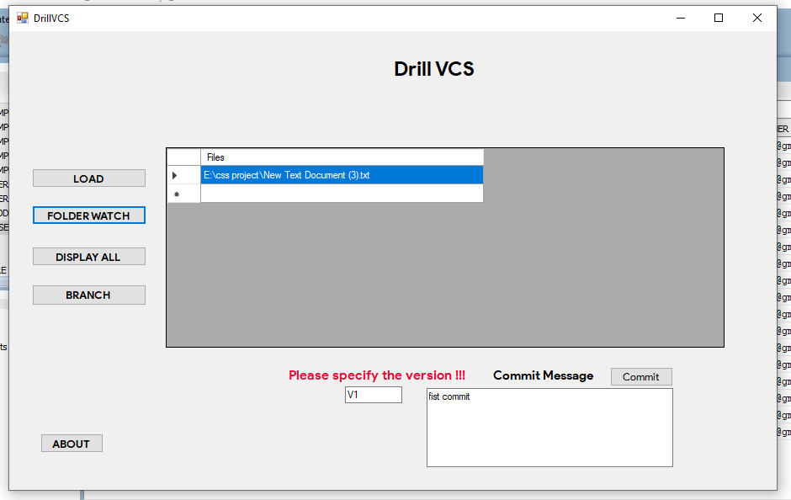
Look for file changes, added in the added project by pressing folder watch button

Slide 20
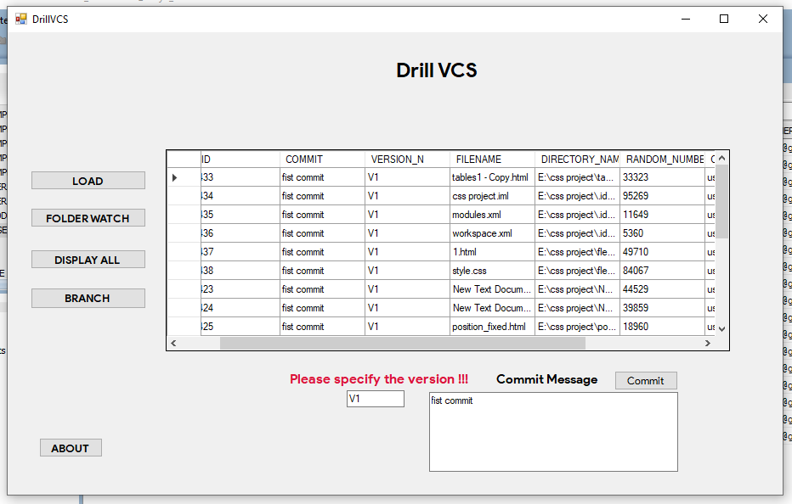
Display the content in the database for a specific user by pressing Display All button.

Slide 21
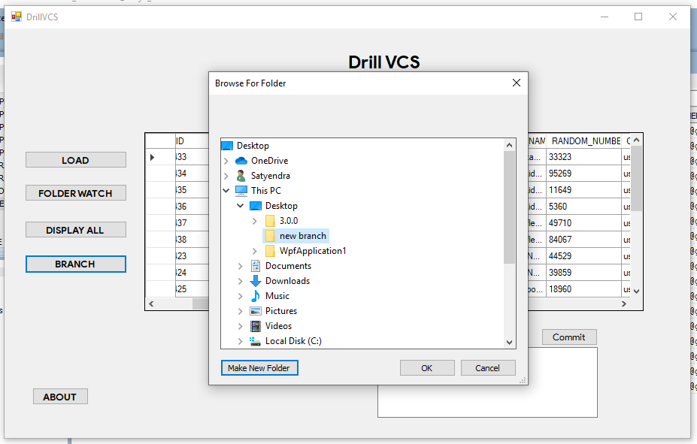
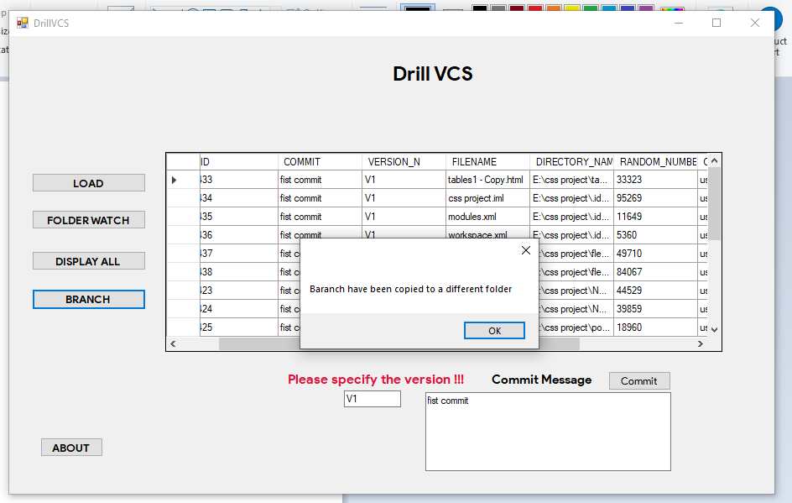
Create a branch for a specific project.
Files are copied to the specified location.
Files copied.

Slide 22
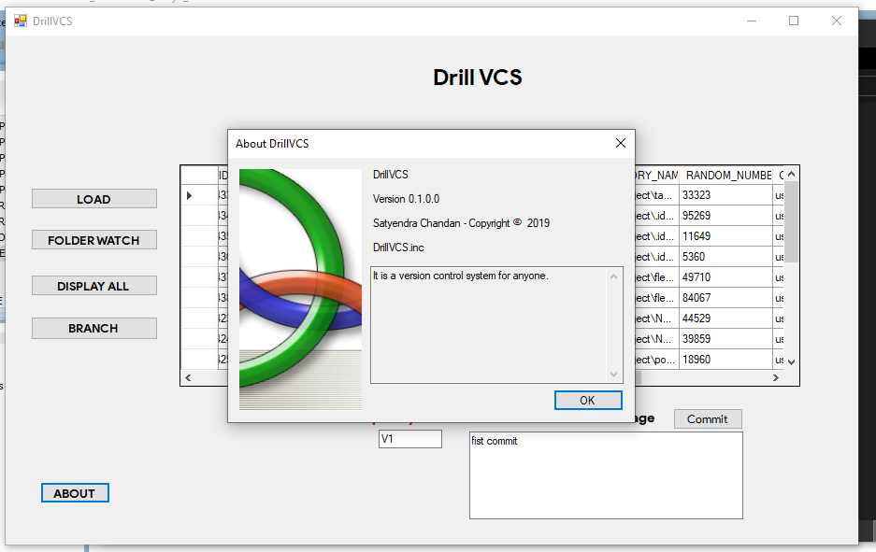
About DrillVCS

Slide 23
THERE IS A SOFTWARE DEMO VIDEO IN THE NEXT SLIDE.
PLEASE WATCH.

Slide 24
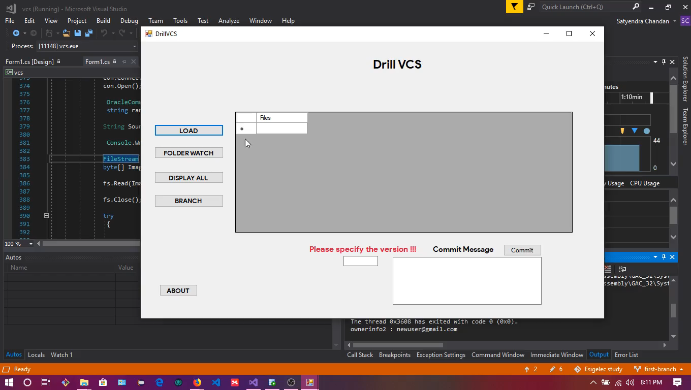

Slide 25
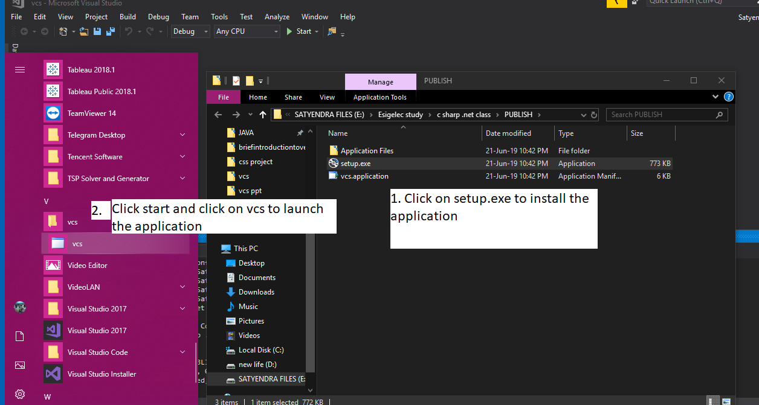

Slide 26
THANK YOU
Regards
--Satyendra CHANDAN

